Slide 1
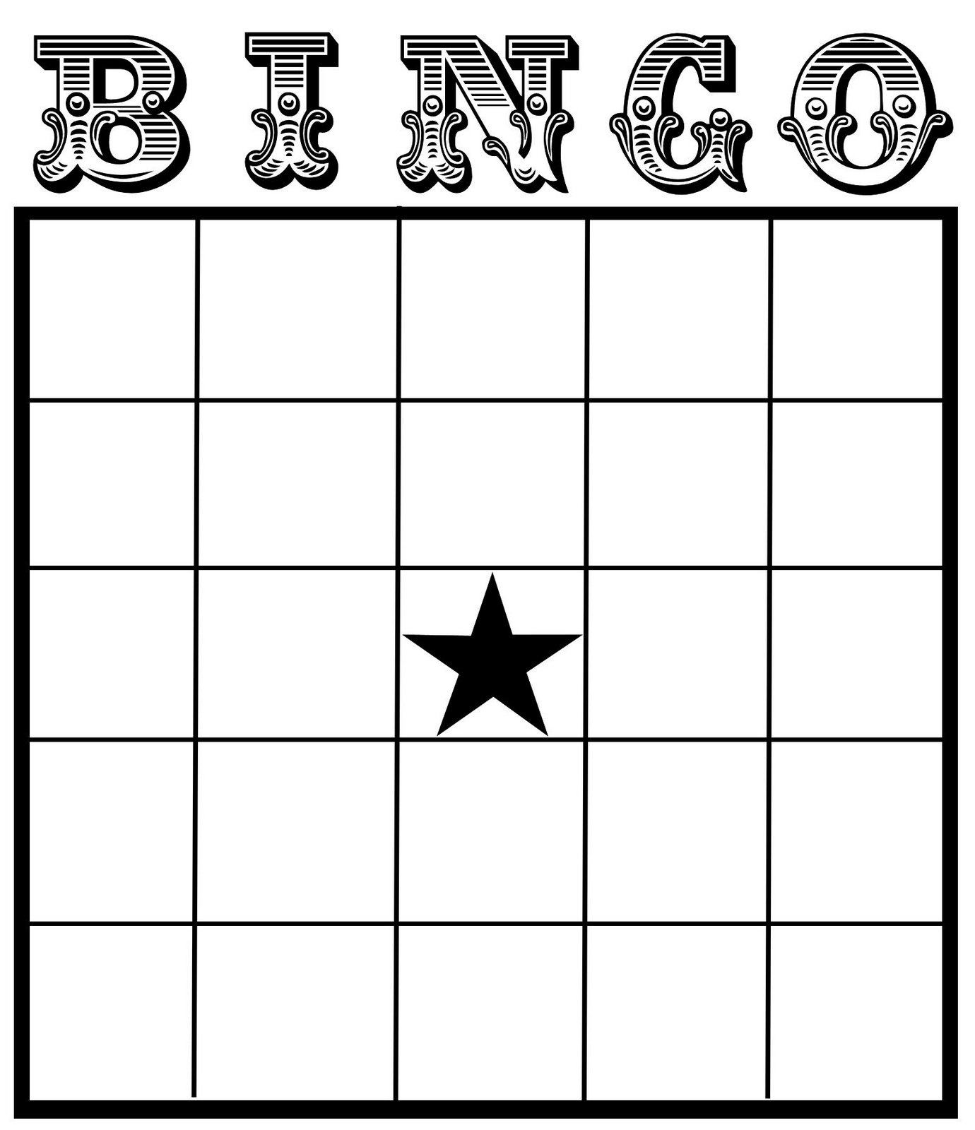
EVERY THURSDAY
$100 O
T
T
E
R
G
A
M
E
P
R
I
Z
E
S
52
63
85
55
27
69
16
23
77
36
73
42
22
21
44
29
17
49
65
32
14
13
99
18
Otter Springs will be hosting BINGO! every Thursday night from 7-9 PM in the Lodge at 6470 SW 80th Ave Trenton, FL 32693
All proceeds from snacks and beverages go to Camp Valor Project at Otter Springs.
Call for more information: (352) 463-0800

